Slide 1

Maths 17
The End…?

Slide 2
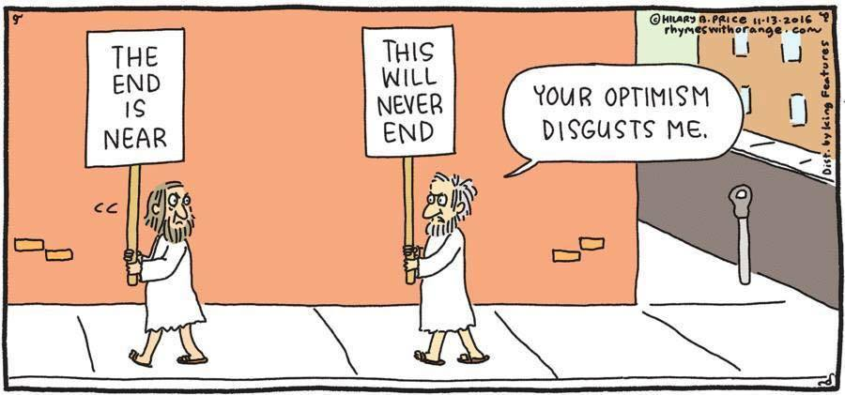
Differential Equation Finale

Slide 3
Homogenous Differential Equations
So we have looked at simple differential equations and linear differential equations.
We have another form of differential equation called homogenous.

Slide 4
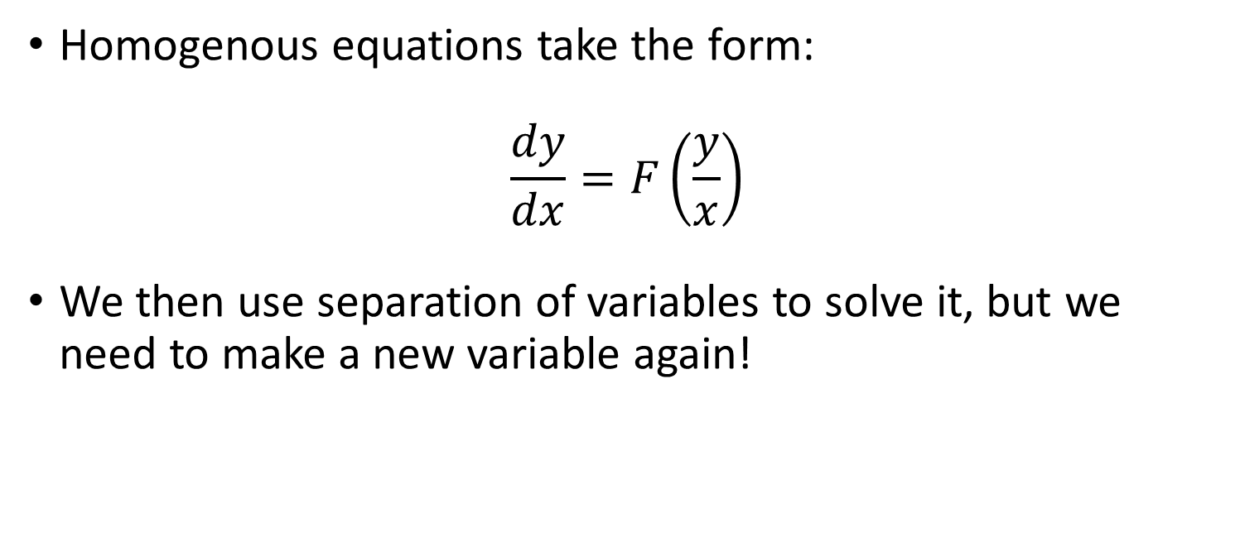
Homogenous Differential Equations
Homogenous equations take the form:
$$\frac{dy}{dx}=F\left(\frac{y}{x}\right)$$
We then use separation of variables to solve it, but we need to make a new variable again!

Slide 5

Homogenous Differential Equations
Homogenous equations take the form:
$$\frac{dy}{dx}=F\left(\frac{y}{x}\right)$$
We create a variable $v=\frac{y}{x}$

Slide 6
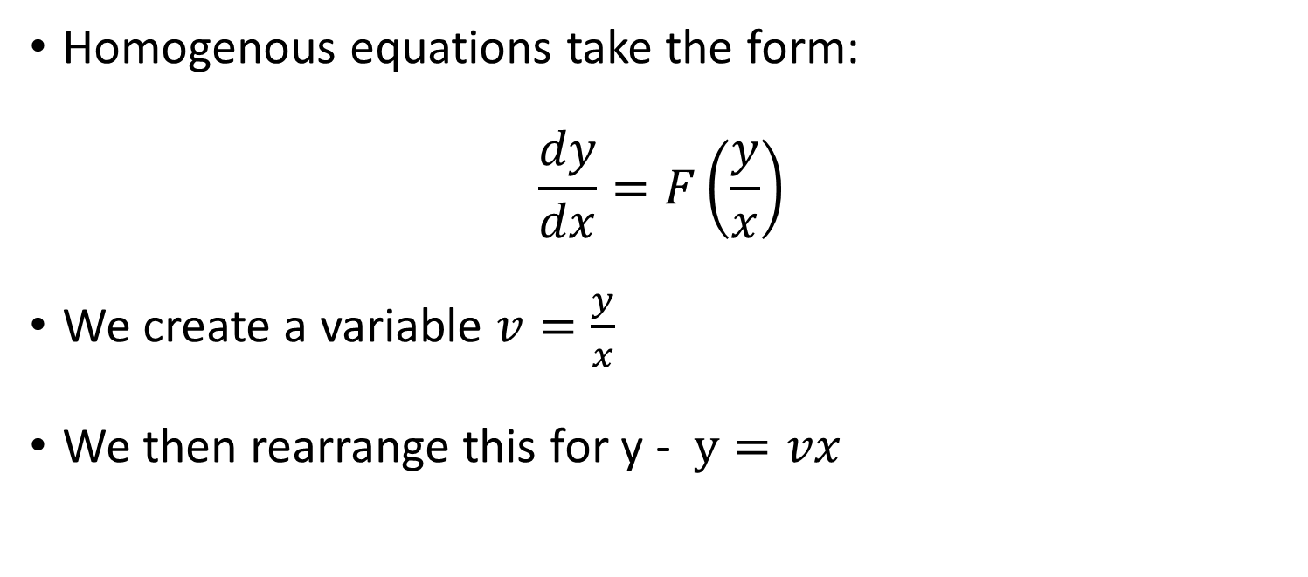
Homogenous Differential Equations
Homogenous equations take the form:
$$\frac{dy}{dx}=F\left(\frac{y}{x}\right)$$
We create a variable $v=\frac{y}{x}$
We then rearrange this for y - $y=vx$

Slide 7
Homogenous Differential Equations
Homogenous equations take the form:
$$\frac{dy}{dx}=F\left(\frac{y}{x}\right)$$
We create a variable $v=\frac{y}{x}$
We then rearrange this for y - $y=vx$

Slide 8

Homogenous Differential Equations
We now have to work out the derivative of y in terms of vx:
$$y=vx$$
$$\frac{dy}{dx}=\frac{d\left(vx\right)}{dx}$$

Slide 9
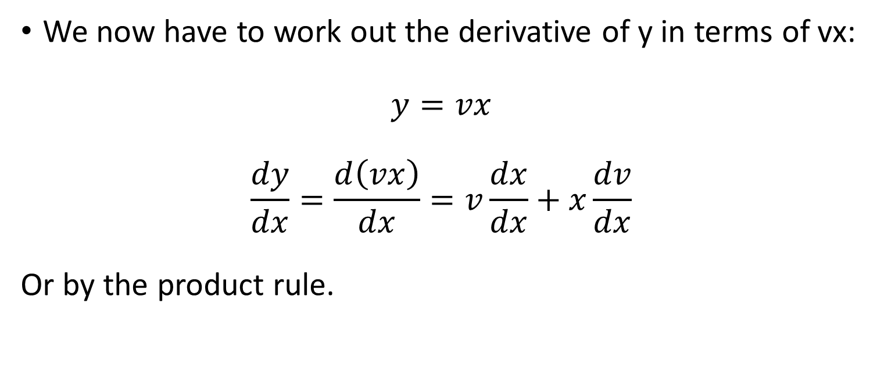
Homogenous Differential Equations
We now have to work out the derivative of y in terms of vx:
$$y=vx$$
$$\frac{dy}{dx}=\frac{d\left(vx\right)}{dx}=v\frac{dx}{dx}+x\frac{dv}{dx}$$
Or by the product rule.

Slide 10
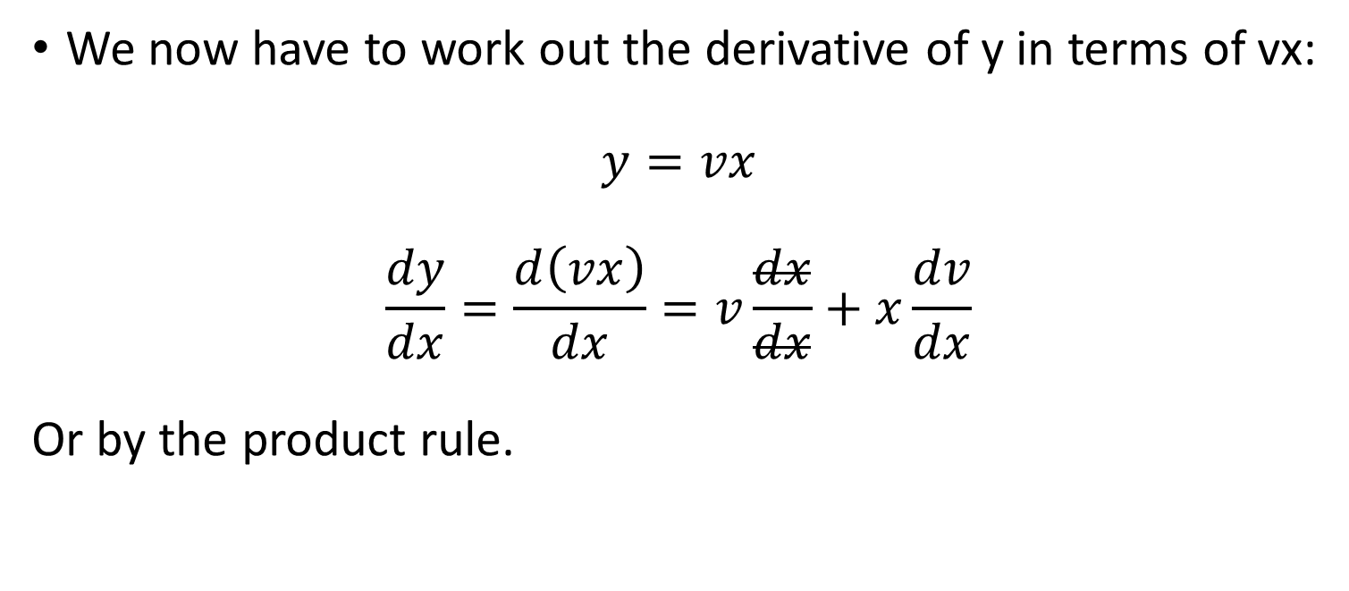
Homogenous Differential Equations
We now have to work out the derivative of y in terms of vx:
$$y=vx$$
$$\frac{dy}{dx}=\frac{d\left(vx\right)}{dx}=v\frac{dx}{dx}+x\frac{dv}{dx}$$
Or by the product rule.

Slide 11
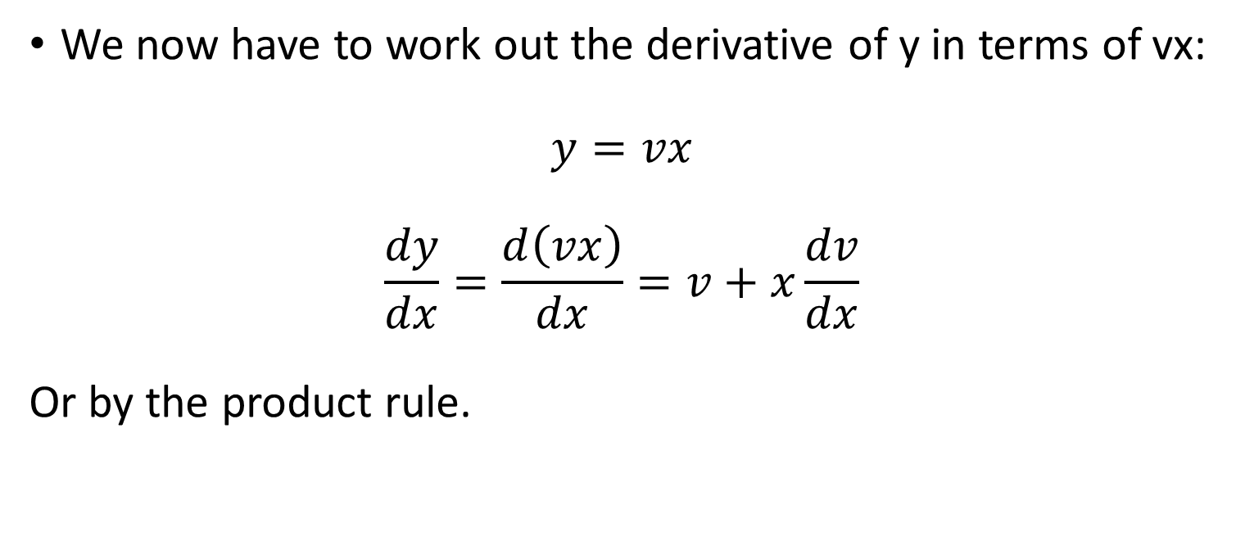
Homogenous Differential Equations
We now have to work out the derivative of y in terms of vx:
$$y=vx$$
$$\frac{dy}{dx}=\frac{d\left(vx\right)}{dx}=v+x\frac{dv}{dx}$$
Or by the product rule.

Slide 12

Homogenous Differential Equations
So we substitute this into our original equation.
$$v+x\frac{dv}{dx}=F(v)$$

Slide 13

Homogenous Differential Equations
Now we have a method we should give it a go.
$$v+x\frac{dv}{dx}=F(v)$$

Slide 14

Homogenous Differential Equations
Now we have a method we should give it a go.
$$v+x\frac{dv}{dx}=F(v)$$
$$\frac{dy}{dx}=\frac{x^{2}+y^{2}}{xy}$$

Slide 15
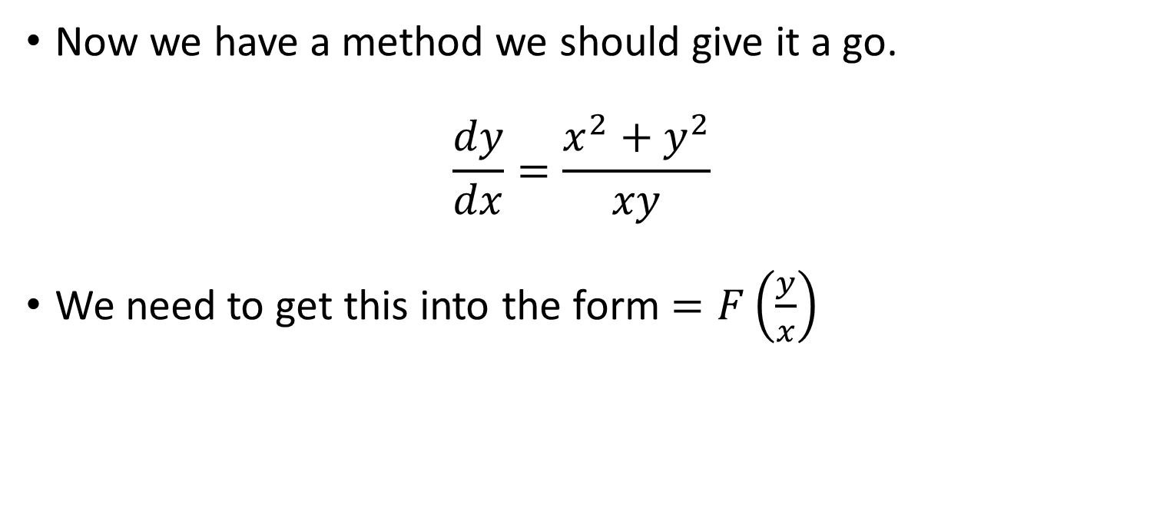
Homogenous Differential Equations
Now we have a method we should give it a go.
$$\frac{dy}{dx}=\frac{x^{2}+y^{2}}{xy}$$
We need to get this into the form $=F\left(\frac{y}{x}\right)$

Slide 16

Homogenous Differential Equations
Now we have a method we should give it a go.
$$\frac{dy}{dx}=\frac{x^{2}+y^{2}}{xy}$$
Start with rearranging it.

Slide 17
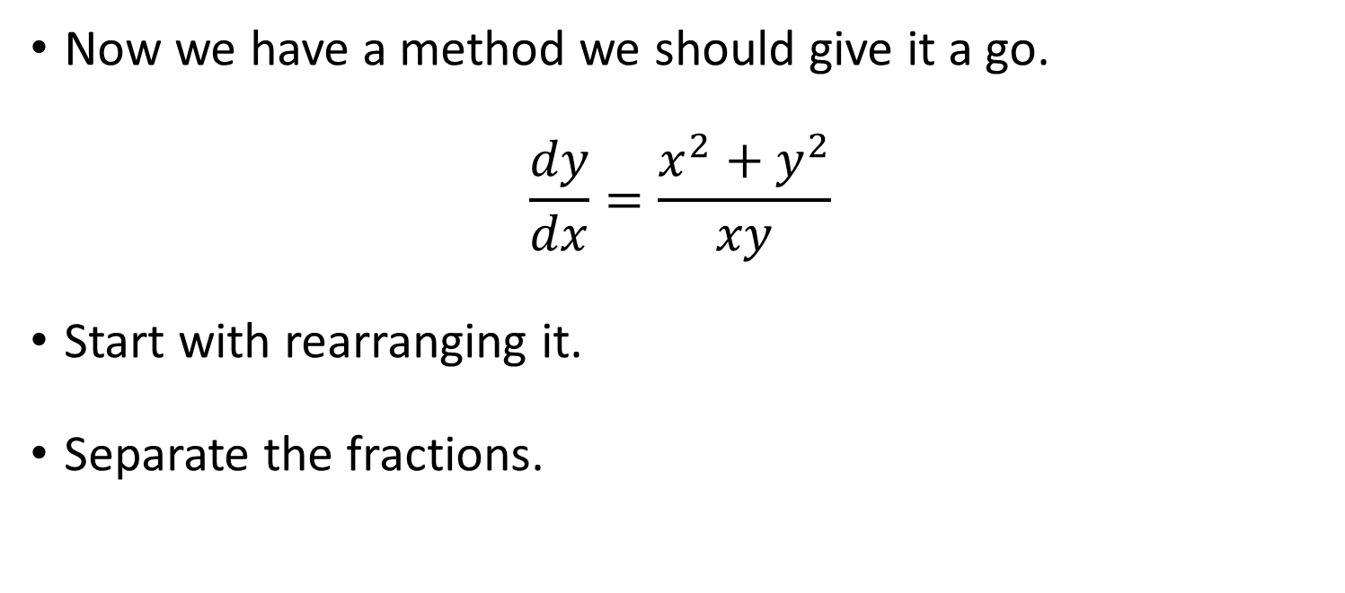
Homogenous Differential Equations
Now we have a method we should give it a go.
$$\frac{dy}{dx}=\frac{x^{2}+y^{2}}{xy}$$
Start with rearranging it.
Separate the fractions.

Slide 18
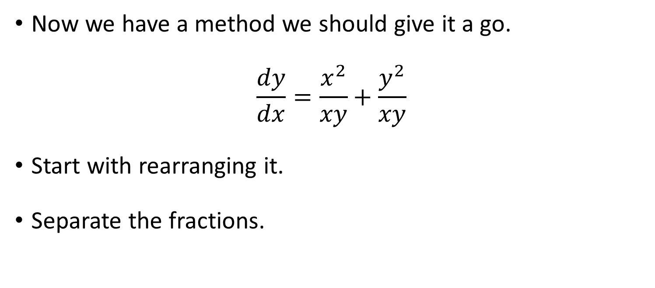
Homogenous Differential Equations
Now we have a method we should give it a go.
$$\frac{dy}{dx}=\frac{x^{2}}{xy}+\frac{y^{2}}{xy}$$
Start with rearranging it.
Separate the fractions.

Slide 19
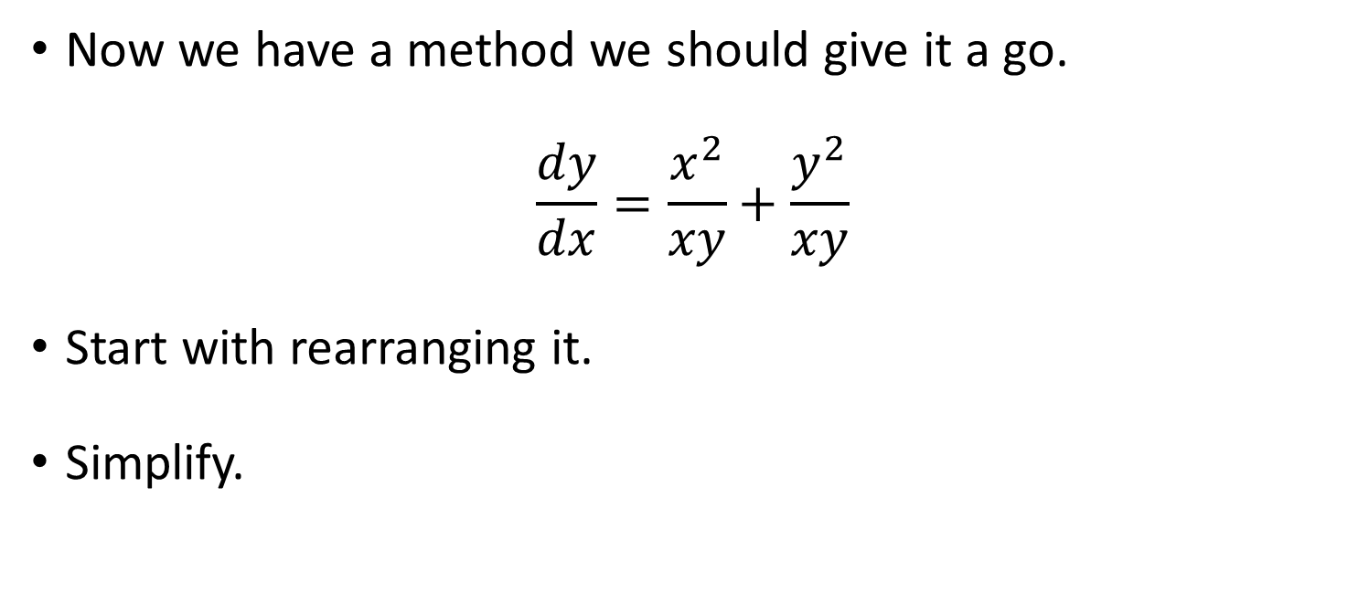
Homogenous Differential Equations
Now we have a method we should give it a go.
$$\frac{dy}{dx}=\frac{x^{2}}{xy}+\frac{y^{2}}{xy}$$
Start with rearranging it.
Simplify.

Slide 20

Homogenous Differential Equations
Now we have a method we should give it a go.
$$\frac{dy}{dx}=\frac{x}{y}+\frac{y}{x}$$
Start with rearranging it.
Simplify.

Slide 21
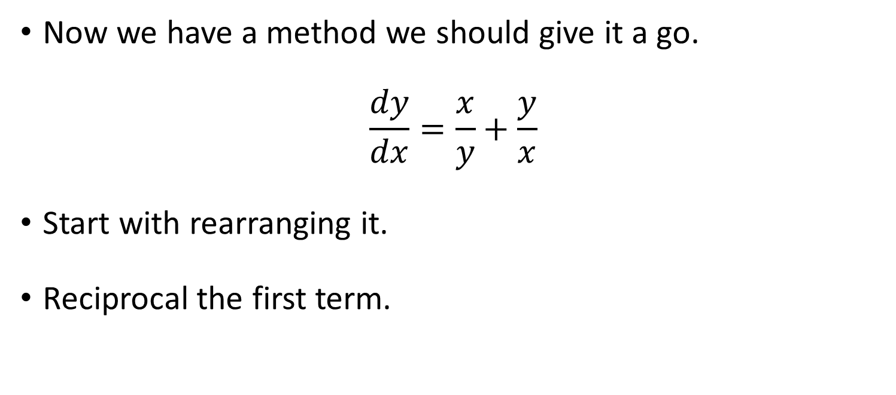
Homogenous Differential Equations
Now we have a method we should give it a go.
$$\frac{dy}{dx}=\frac{x}{y}+\frac{y}{x}$$
Start with rearranging it.
Reciprocal the first term.

Slide 22
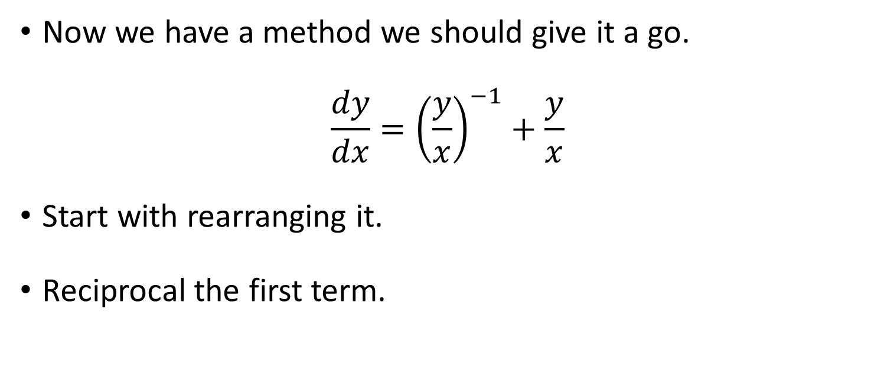
Homogenous Differential Equations
Now we have a method we should give it a go.
$$\frac{dy}{dx}={\left(\frac{y}{x}\right)}^{−1}+\frac{y}{x}$$
Start with rearranging it.
Reciprocal the first term.

Slide 23
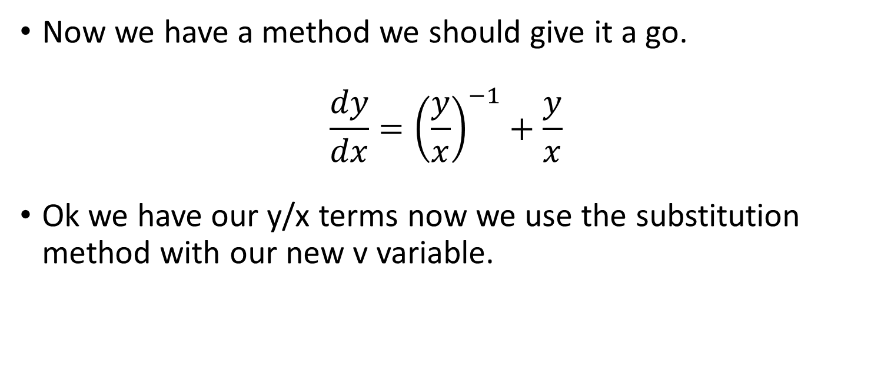
Homogenous Differential Equations
Now we have a method we should give it a go.
$$\frac{dy}{dx}={\left(\frac{y}{x}\right)}^{−1}+\frac{y}{x}$$
Ok we have our y/x terms now we use the substitution method with our new v variable.

Slide 24
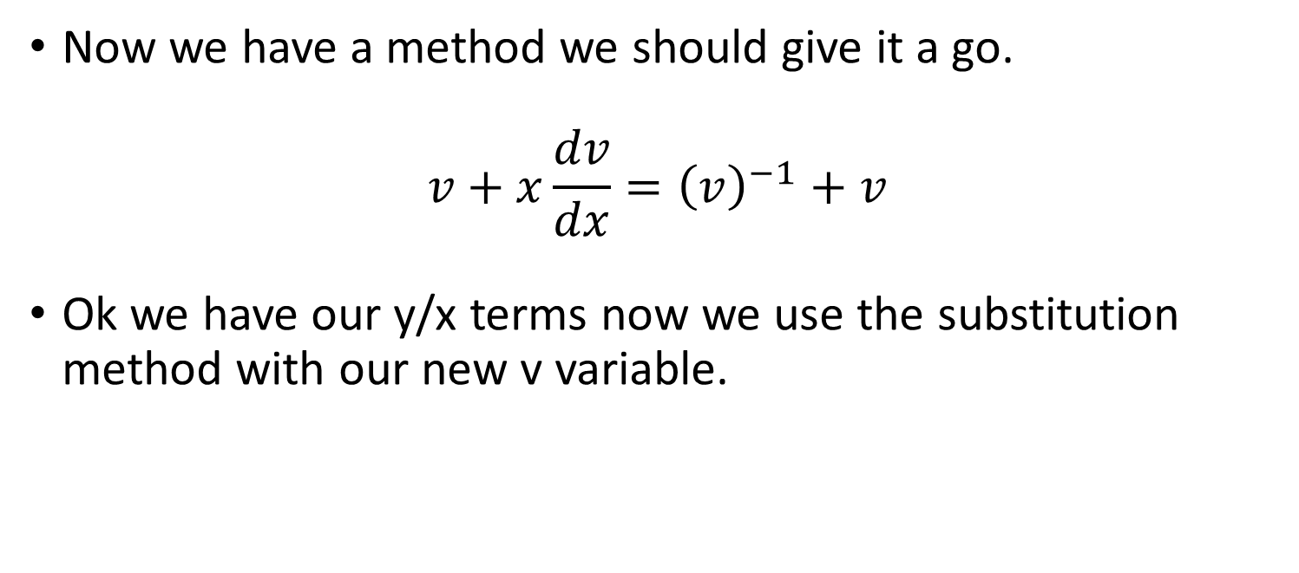
Homogenous Differential Equations
Now we have a method we should give it a go.
$$v+x\frac{dv}{dx}={\left(v\right)}^{−1}+v$$
Ok we have our y/x terms now we use the substitution method with our new v variable.

Slide 25

Homogenous Differential Equations
Now we have a method we should give it a go.
$$v+x\frac{dv}{dx}={\left(v\right)}^{−1}+v$$
Subtract v from both sides.

Slide 26

Homogenous Differential Equations
Now we have a method we should give it a go.
$$x\frac{dv}{dx}={\left(v\right)}^{−1}$$
Subtract v from both sides.

Slide 27

Homogenous Differential Equations
Now we have a method we should give it a go.
$$x\frac{dv}{dx}={\left(v\right)}^{−1}$$
Now we can use separation of variables.

Slide 28
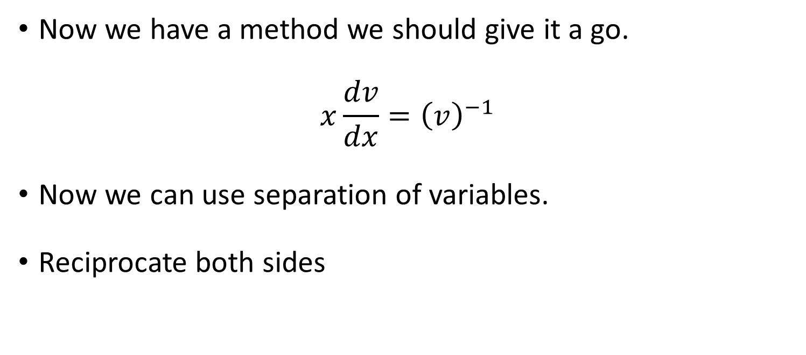
Homogenous Differential Equations
Now we have a method we should give it a go.
$$x\frac{dv}{dx}={\left(v\right)}^{−1}$$
Now we can use separation of variables.
Reciprocate both sides

Slide 29
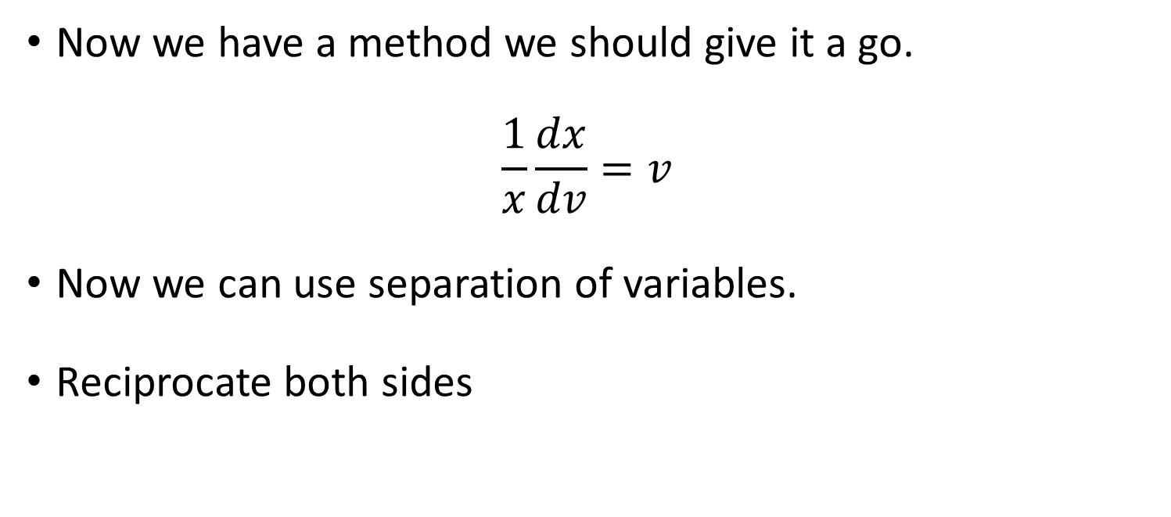
Homogenous Differential Equations
Now we have a method we should give it a go.
$$\frac{1}{x}\frac{dx}{dv}=v$$
Now we can use separation of variables.
Reciprocate both sides

Slide 30
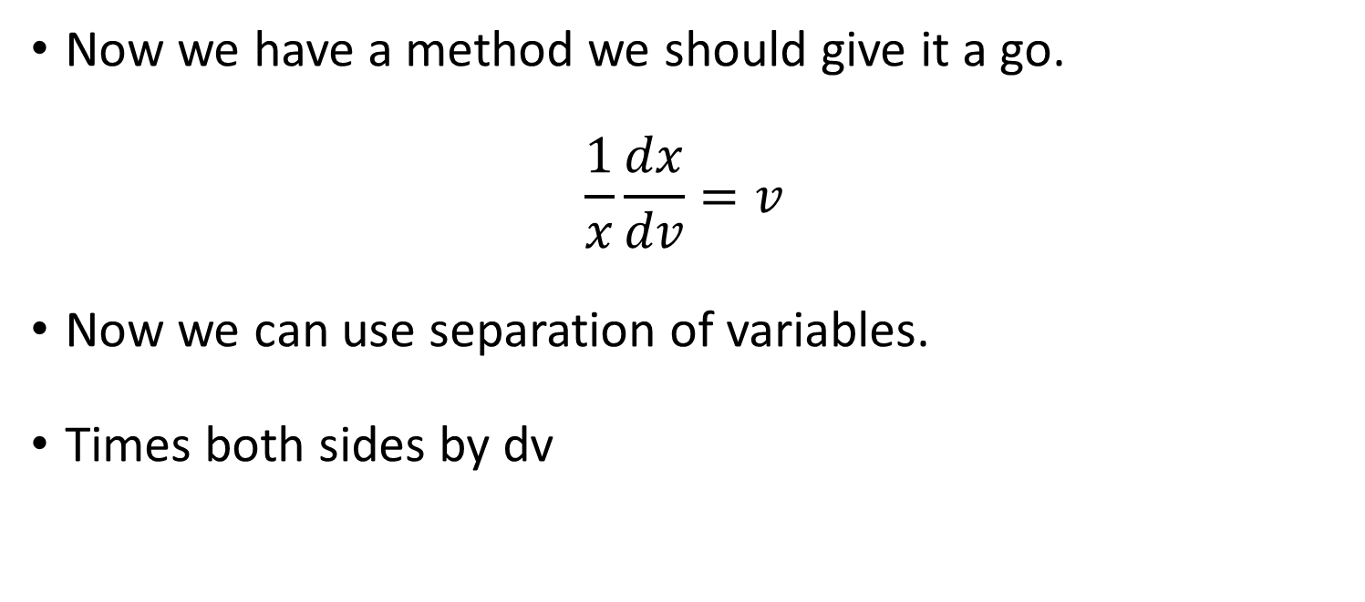
Homogenous Differential Equations
Now we have a method we should give it a go.
$$\frac{1}{x}\frac{dx}{dv}=v$$
Now we can use separation of variables.
Times both sides by dv

Slide 31
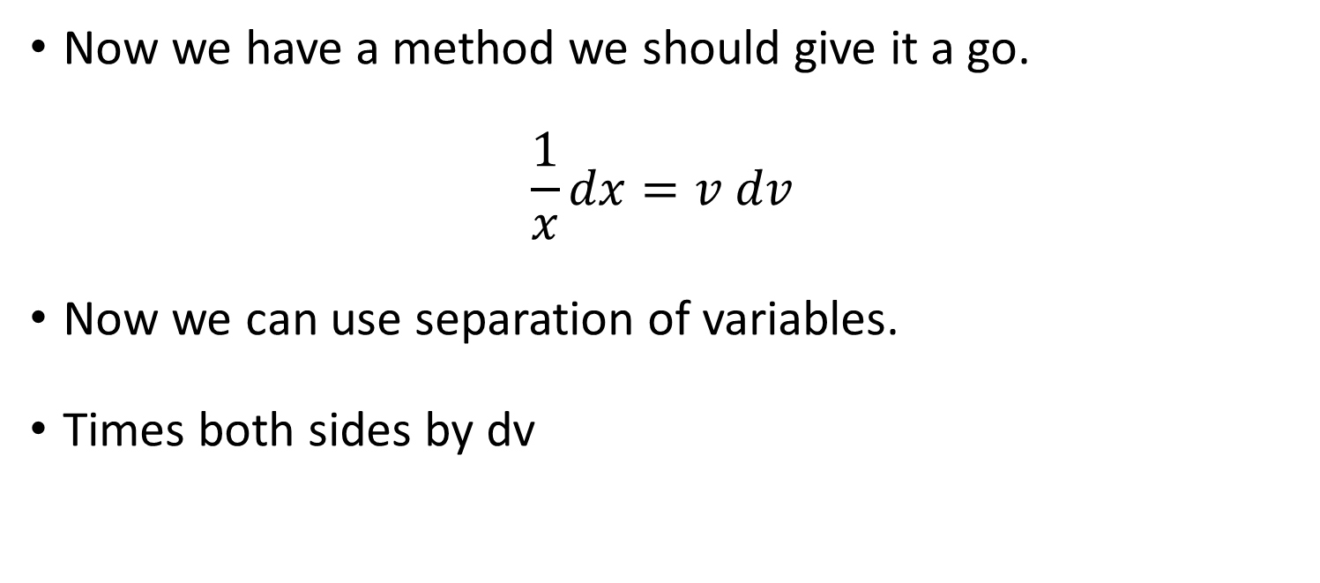
Homogenous Differential Equations
Now we have a method we should give it a go.
$$\frac{1}{x}dx=v dv$$
Now we can use separation of variables.
Times both sides by dv

Slide 32
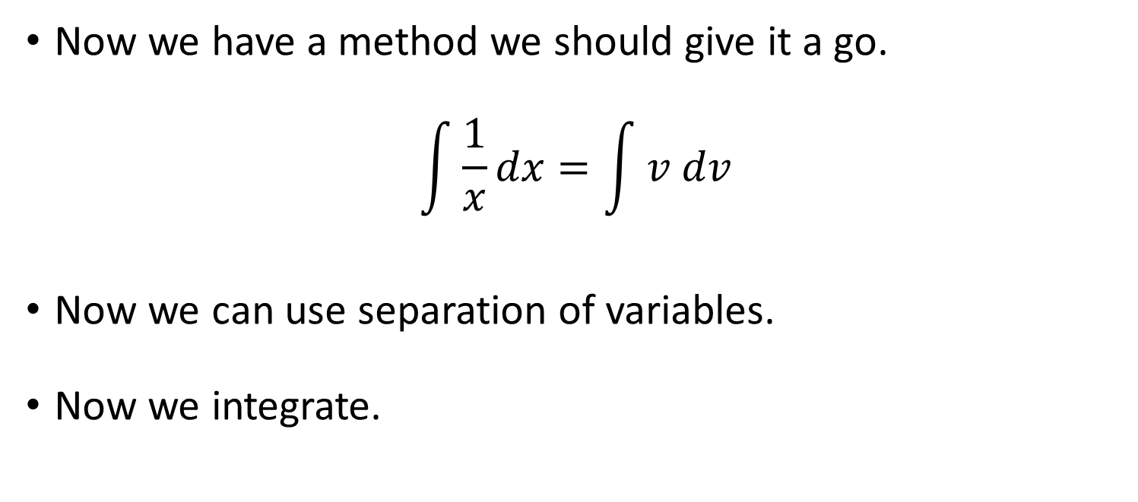
Homogenous Differential Equations
Now we have a method we should give it a go.
$$\int{\frac{1}{x}dx}=\int{v dv}$$
Now we can use separation of variables.
Now we integrate.

Slide 33
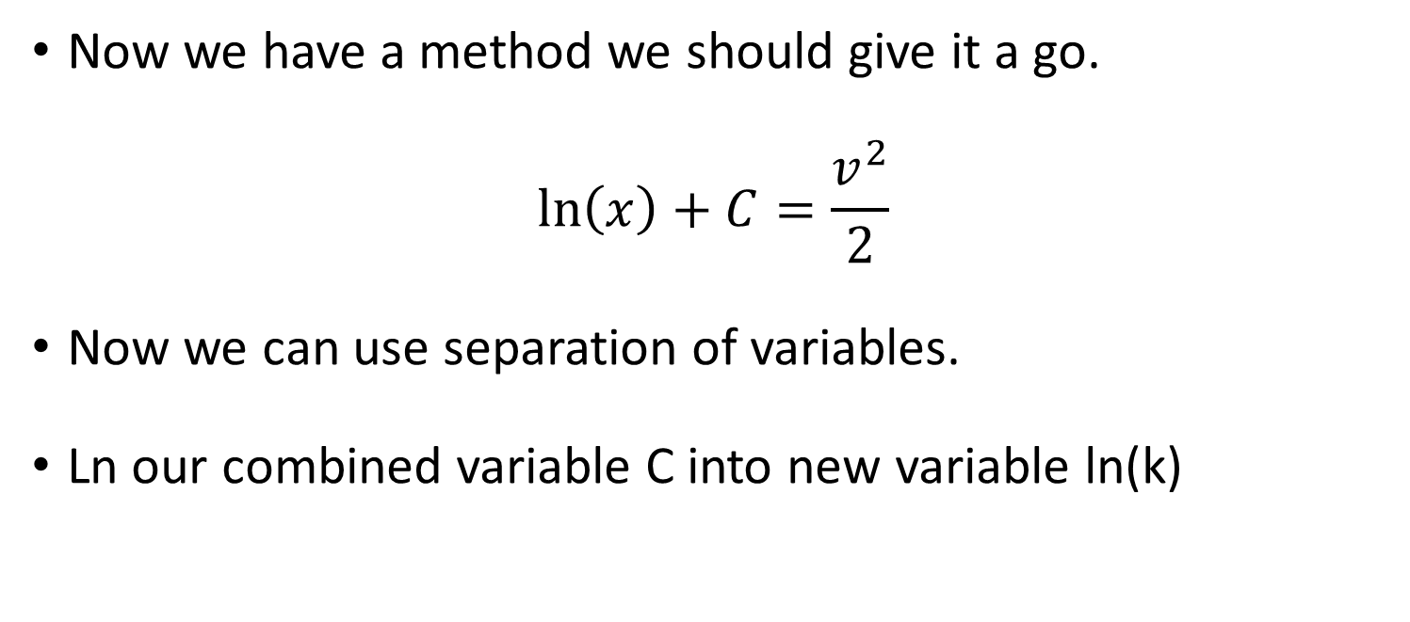
Homogenous Differential Equations
Now we have a method we should give it a go.
$$\ln\left(x\right)+C=\frac{v^{2}}{2}$$
Now we can use separation of variables.
Ln our combined variable C into new variable ln(k)

Slide 34
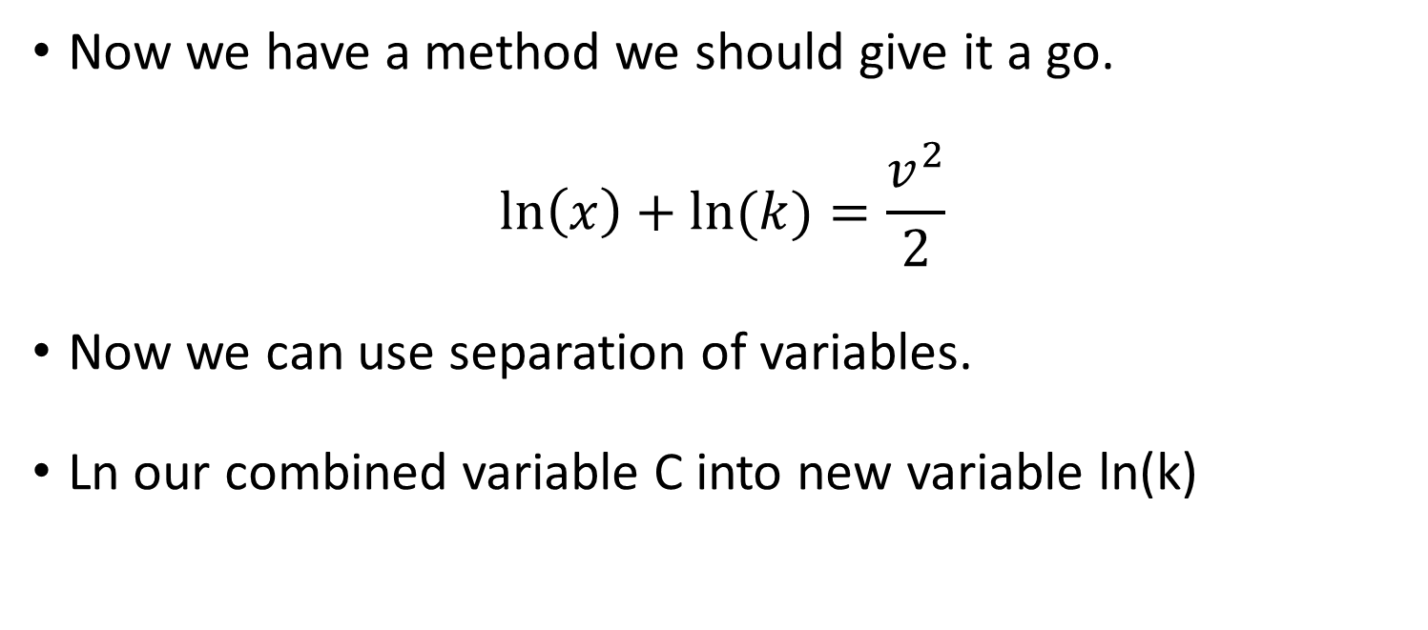
Homogenous Differential Equations
Now we have a method we should give it a go.
$$\ln\left(x\right)+ln⁡(k)=\frac{v^{2}}{2}$$
Now we can use separation of variables.
Ln our combined variable C into new variable ln(k)

Slide 35
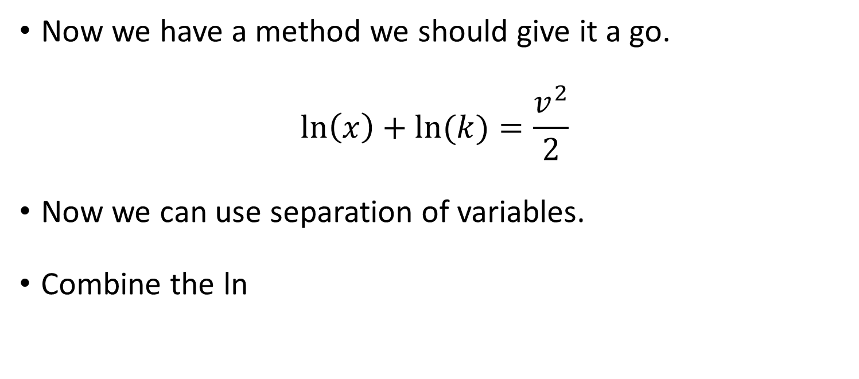
Homogenous Differential Equations
Now we have a method we should give it a go.
$$\ln\left(x\right)+ln⁡(k)=\frac{v^{2}}{2}$$
Now we can use separation of variables.
Combine the ln

Slide 36
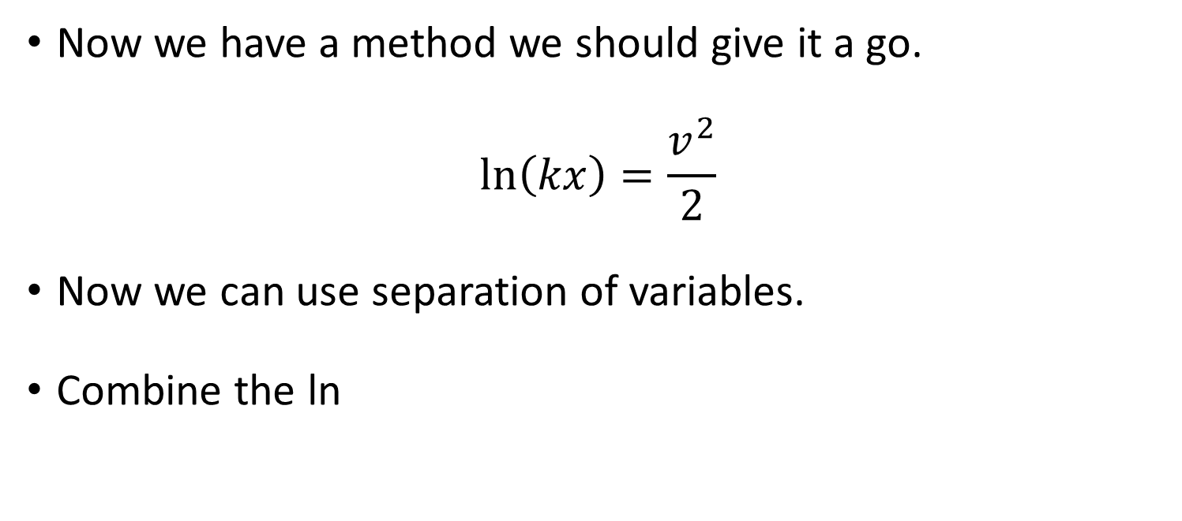
Homogenous Differential Equations
Now we have a method we should give it a go.
$$\ln\left(kx\right)=\frac{v^{2}}{2}$$
Now we can use separation of variables.
Combine the ln

Slide 37
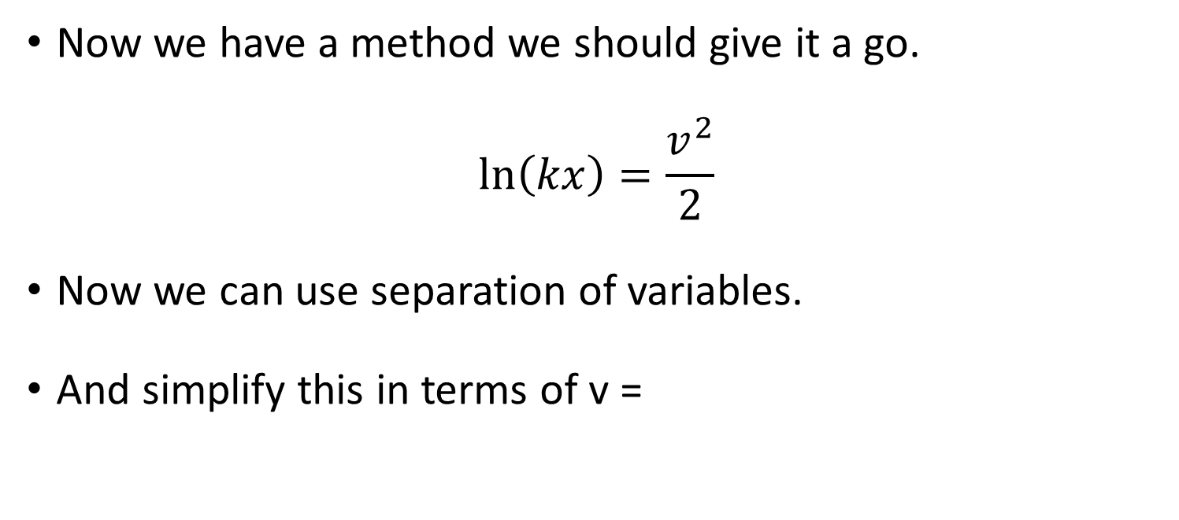
Homogenous Differential Equations
Now we have a method we should give it a go.
$$\ln\left(kx\right)=\frac{v^{2}}{2}$$
Now we can use separation of variables.
And simplify this in terms of v =

Slide 38
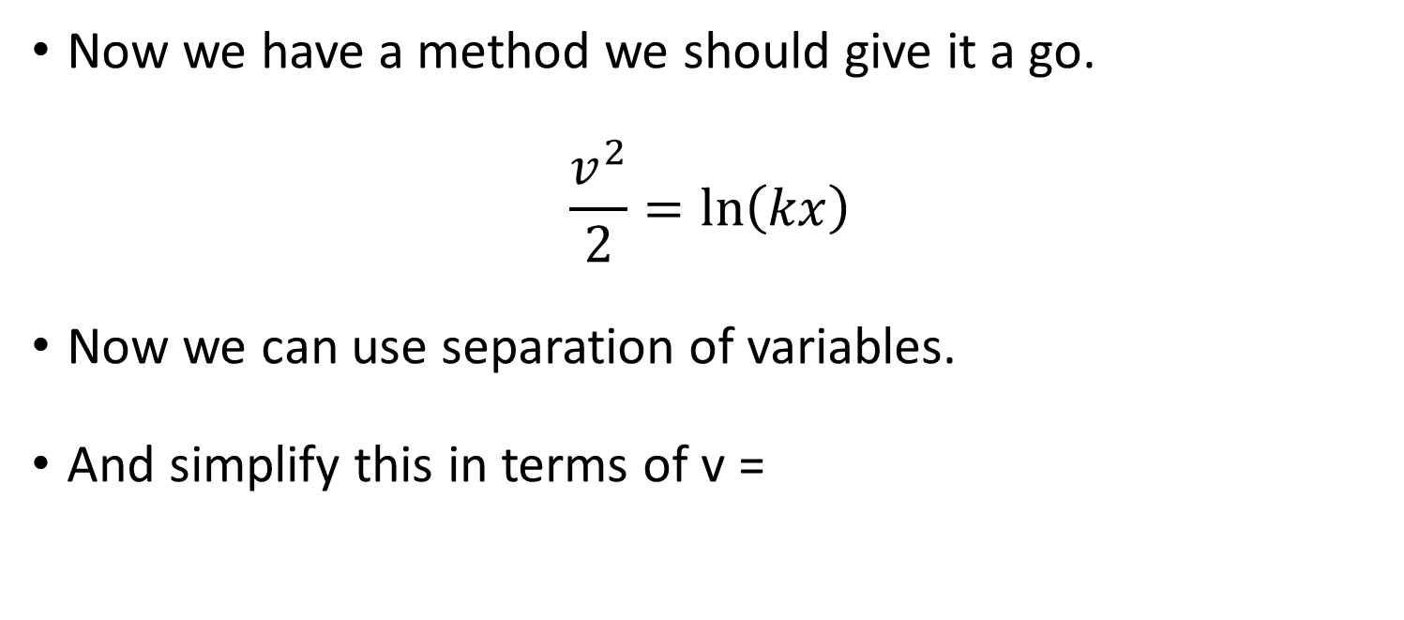
Homogenous Differential Equations
Now we have a method we should give it a go.
$$\frac{v^{2}}{2}=ln\left(kx\right)$$
Now we can use separation of variables.
And simplify this in terms of v =

Slide 39
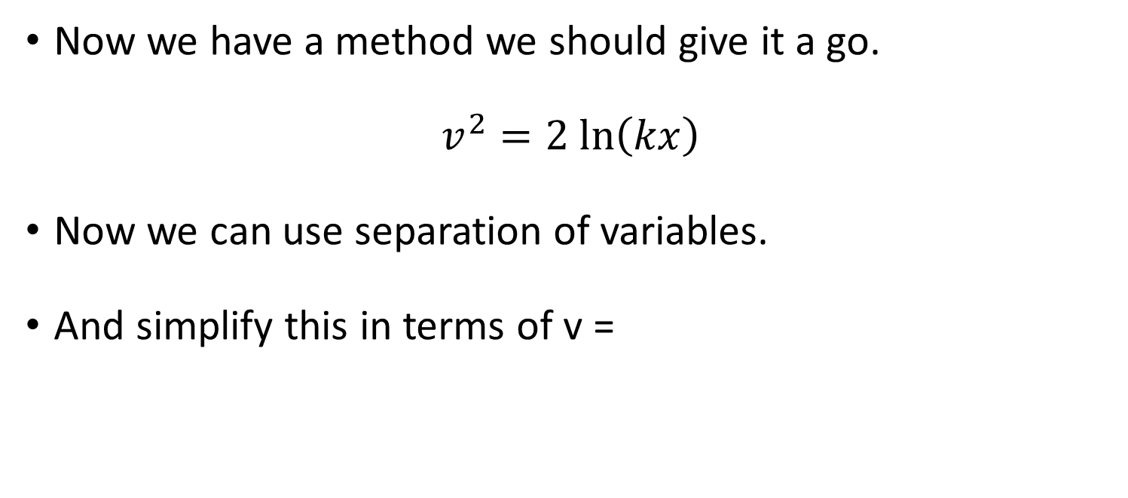
Homogenous Differential Equations
Now we have a method we should give it a go.
$$v^{2}=2 ln\left(kx\right)$$
Now we can use separation of variables.
And simplify this in terms of v =

Slide 40
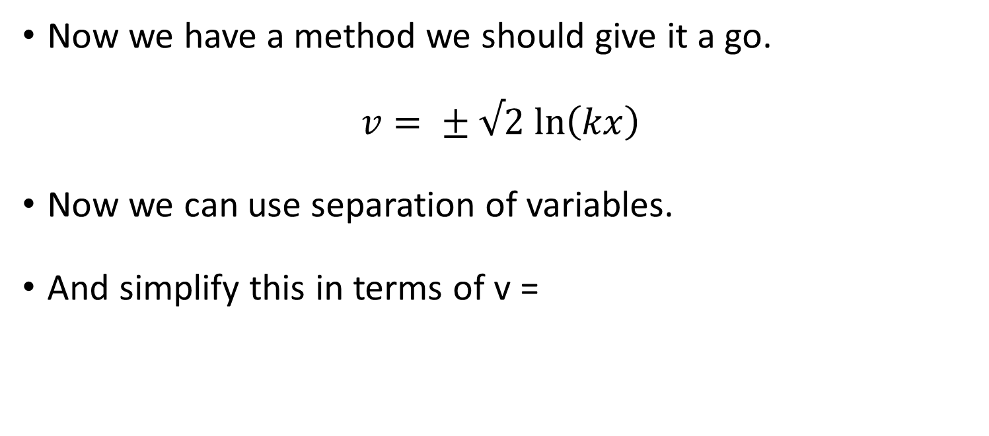
Homogenous Differential Equations
Now we have a method we should give it a go.
$$v= ± √2 ln\left(kx\right)$$
Now we can use separation of variables.
And simplify this in terms of v =

Slide 41
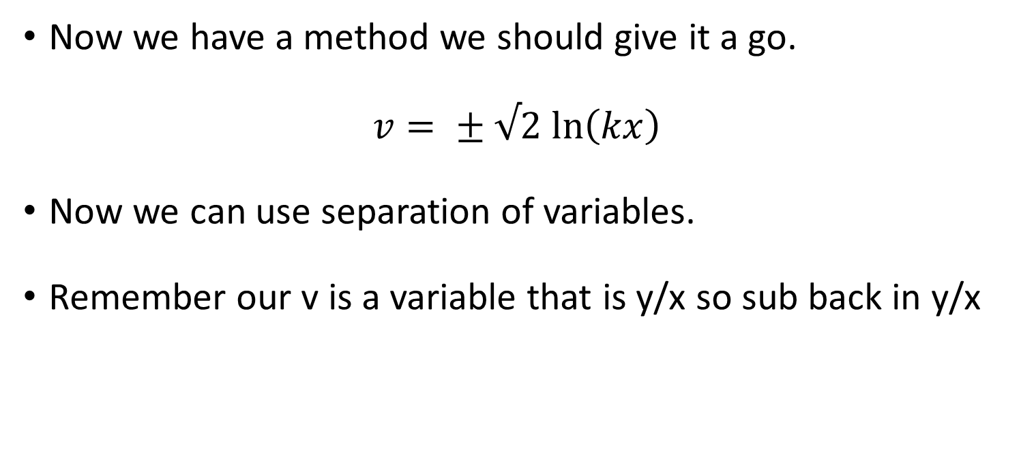
Homogenous Differential Equations
Now we have a method we should give it a go.
$$v= ± √2 ln\left(kx\right)$$
Now we can use separation of variables.
Remember our v is a variable that is y/x so sub back in y/x

Slide 42
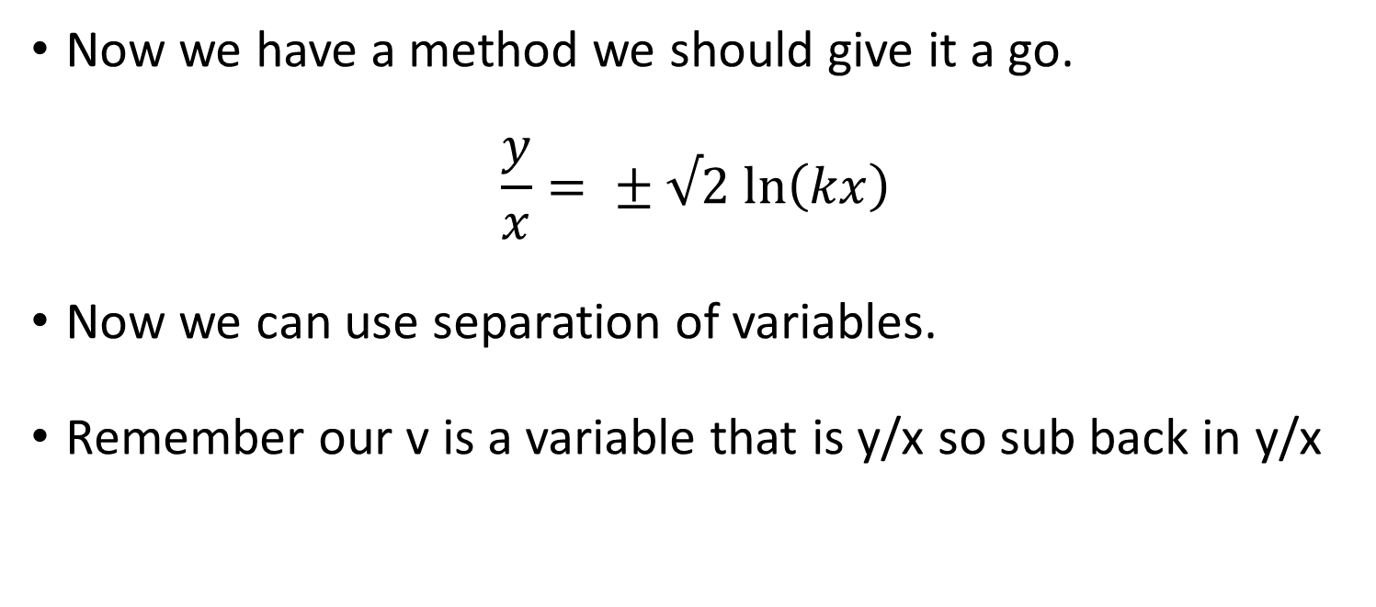
Homogenous Differential Equations
Now we have a method we should give it a go.
$$\frac{y}{x}= ± √2 ln\left(kx\right)$$
Now we can use separation of variables.
Remember our v is a variable that is y/x so sub back in y/x

Slide 43
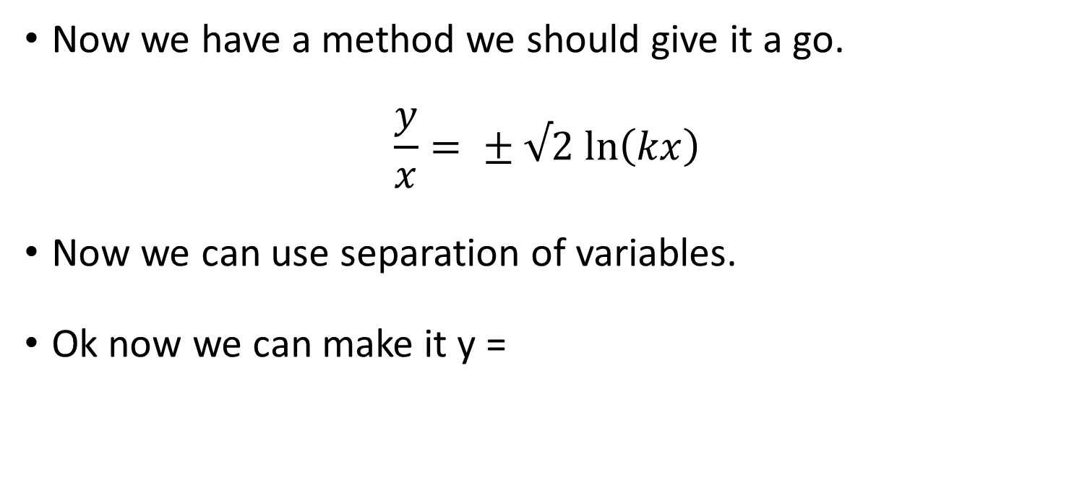
Homogenous Differential Equations
Now we have a method we should give it a go.
$$\frac{y}{x}= ± √2 ln\left(kx\right)$$
Now we can use separation of variables.
Ok now we can make it y =

Slide 44
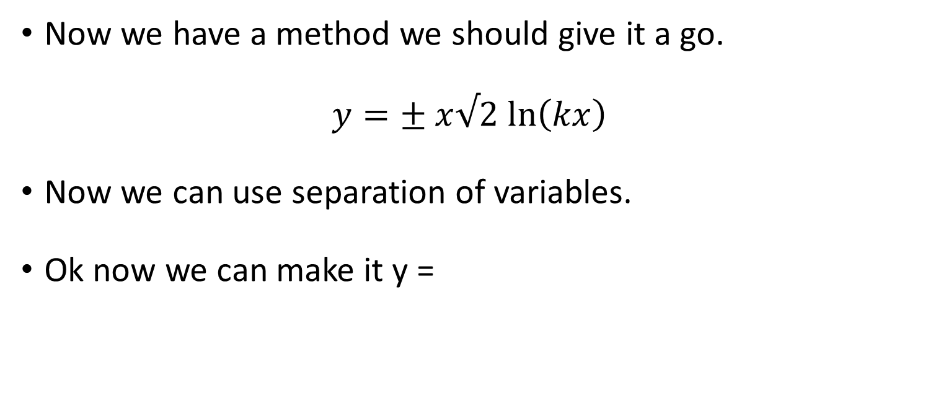
Homogenous Differential Equations
Now we have a method we should give it a go.
$$y=± x√2 ln\left(kx\right)$$
Now we can use separation of variables.
Ok now we can make it y =

Slide 45
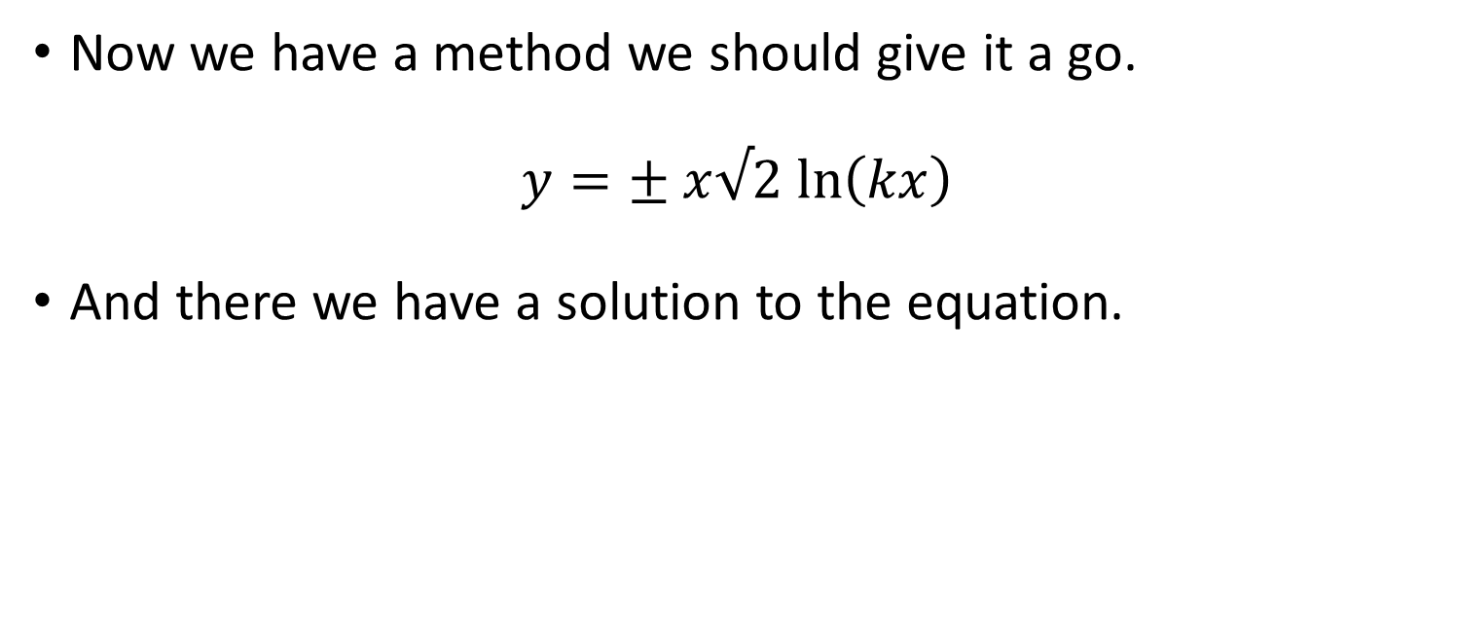
Homogenous Differential Equations
Now we have a method we should give it a go.
$$y=± x√2 ln\left(kx\right)$$
And there we have a solution to the equation.

Slide 46
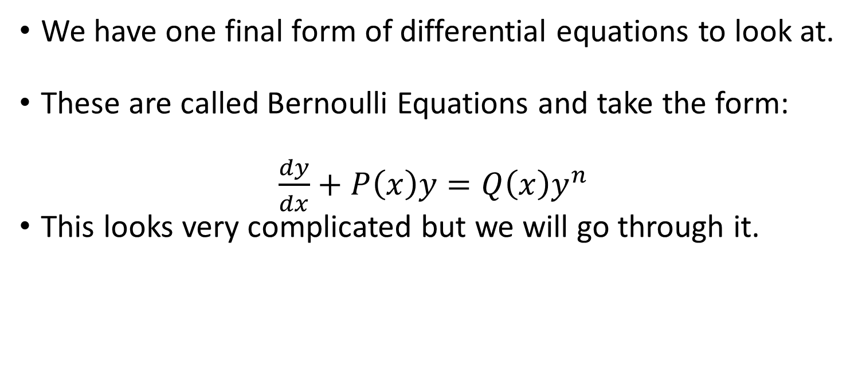
Bernoulli Differential Equations
We have one final form of differential equations to look at.
These are called Bernoulli Equations and take the form:
$\frac{dy}{dx}+P\left(x\right)y=Q\left(x\right)y^{n}$
This looks very complicated but we will go through it.

Slide 47
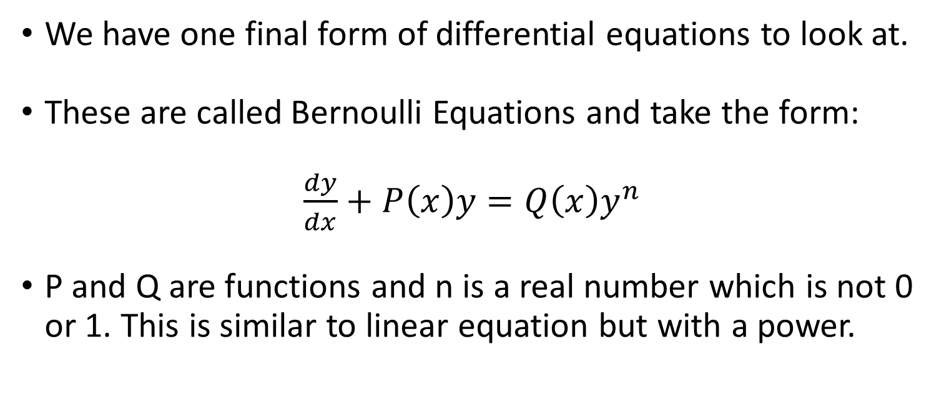
Bernoulli Differential Equations
We have one final form of differential equations to look at.
These are called Bernoulli Equations and take the form:
$\frac{dy}{dx}+P\left(x\right)y=Q\left(x\right)y^{n}$
P and Q are functions and n is a real number which is not 0 or 1. This is similar to linear equation but with a power.

Slide 48
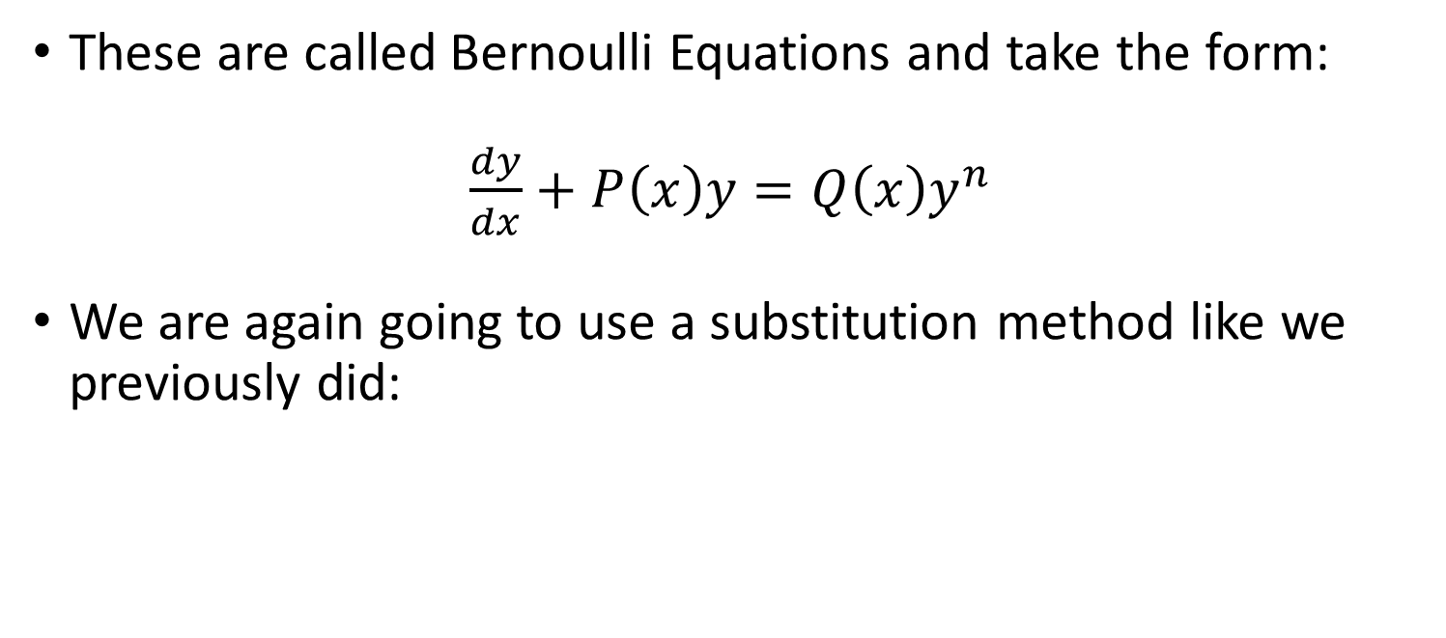
Bernoulli Differential Equations
These are called Bernoulli Equations and take the form:
$\frac{dy}{dx}+P\left(x\right)y=Q\left(x\right)y^{n}$
We are again going to use a substitution method like we previously did:

Slide 49
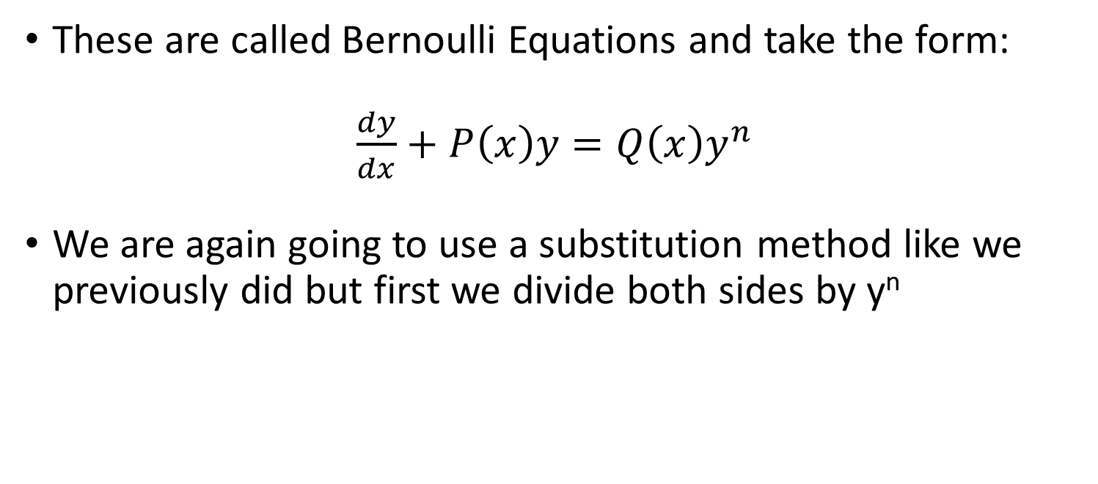
Bernoulli Differential Equations
These are called Bernoulli Equations and take the form:
$\frac{dy}{dx}+P\left(x\right)y=Q\left(x\right)y^{n}$
We are again going to use a substitution method like we previously did but first we divide both sides by y^{n}

Slide 50
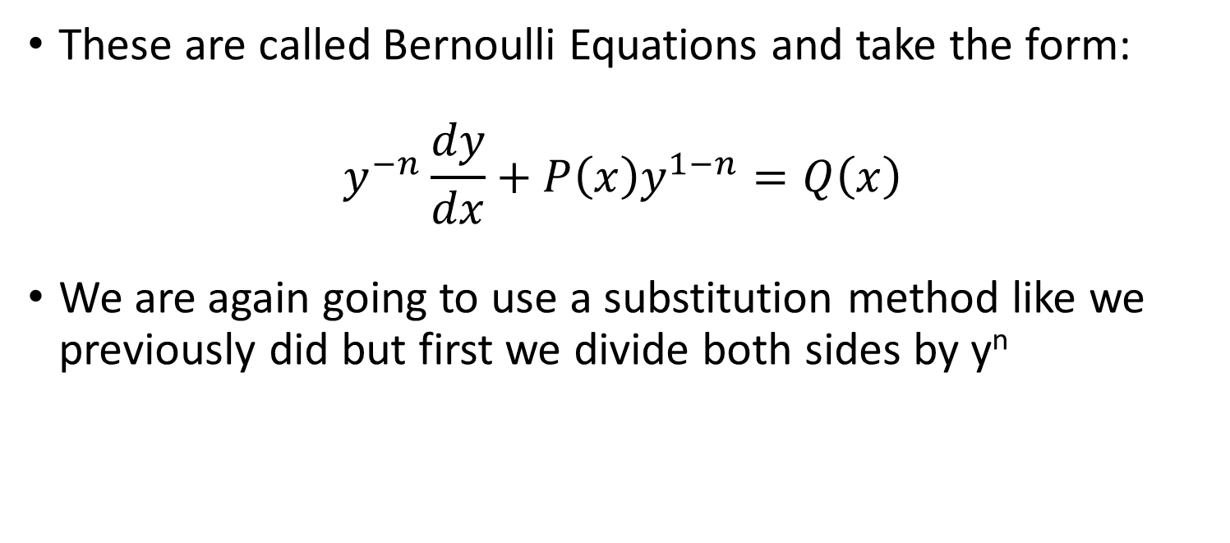
Bernoulli Differential Equations
These are called Bernoulli Equations and take the form:
$$y^{−n}\frac{dy}{dx}+P\left(x\right)y^{1−n}=Q\left(x\right)$$
We are again going to use a substitution method like we previously did but first we divide both sides by y^{n}

Slide 51
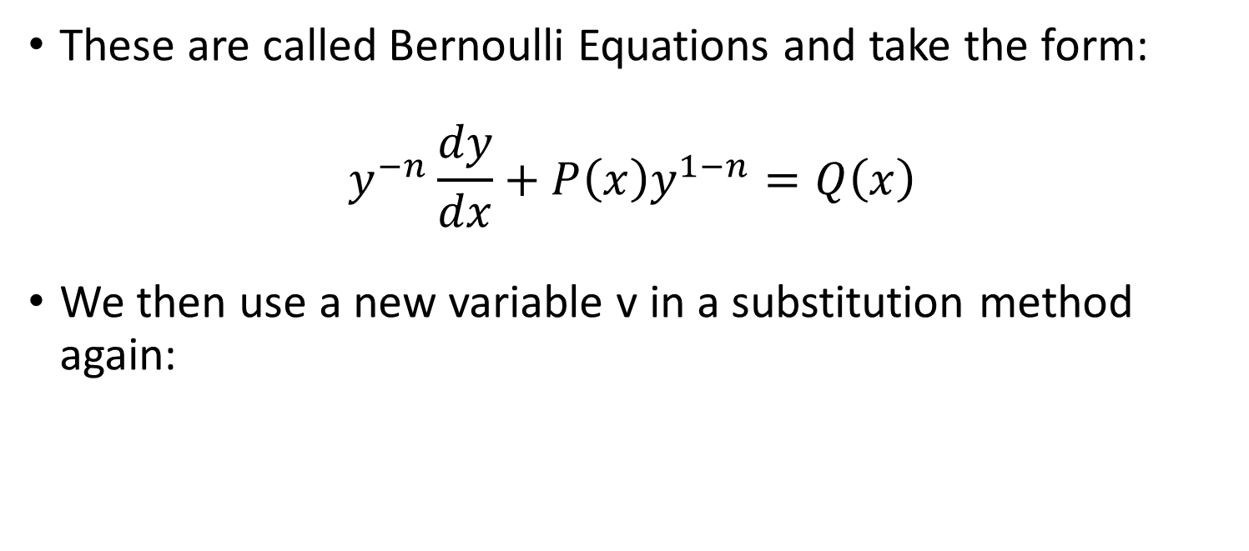
Bernoulli Differential Equations
These are called Bernoulli Equations and take the form:
$$y^{−n}\frac{dy}{dx}+P\left(x\right)y^{1−n}=Q\left(x\right)$$
We then use a new variable v in a substitution method again:

Slide 52
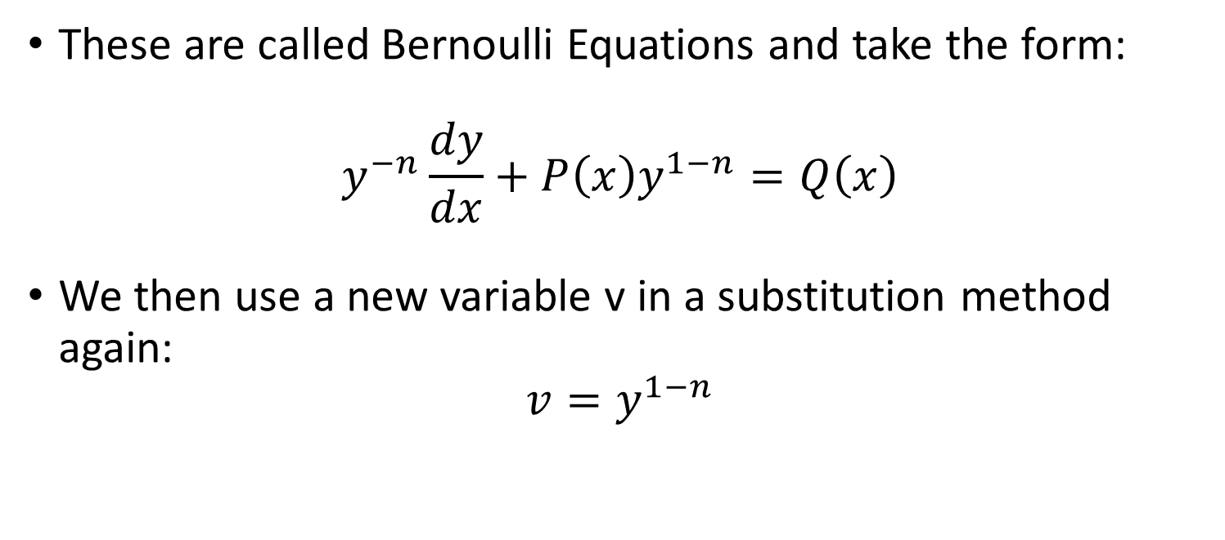
Bernoulli Differential Equations
These are called Bernoulli Equations and take the form:
$$y^{−n}\frac{dy}{dx}+P\left(x\right)y^{1−n}=Q\left(x\right)$$
We then use a new variable v in a substitution method again:
$$v=y^{1−n}$$

Slide 53
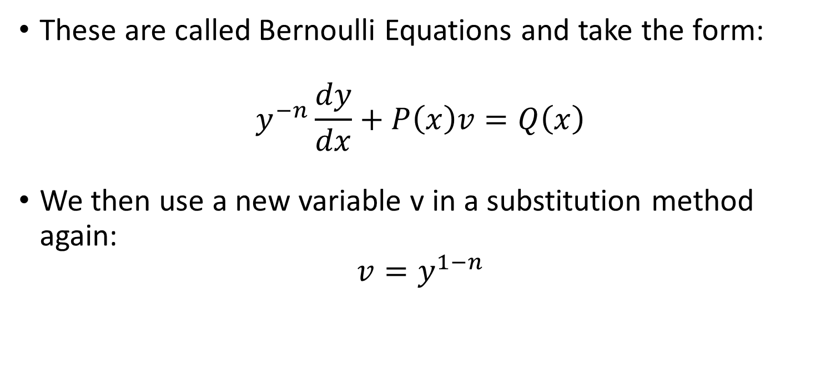
Bernoulli Differential Equations
These are called Bernoulli Equations and take the form:
$$y^{−n}\frac{dy}{dx}+P\left(x\right)v=Q\left(x\right)$$
We then use a new variable v in a substitution method again:
$$v=y^{1−n}$$

Slide 54
Bernoulli Differential Equations
These are called Bernoulli Equations and take the form:
$$y^{−n}\frac{dy}{dx}+P\left(x\right)v=Q\left(x\right)$$
We then use a new variable v in a substitution method again:
$$v=y^{1−n}$$

Slide 55

Bernoulli Differential Equations
These are called Bernoulli Equations and take the form:
$$y^{−n}\frac{dy}{dx}+P\left(x\right)v=Q\left(x\right)$$
We however also need to get the derivative of v
$$v=y^{1−n}$$

Slide 56

Bernoulli Differential Equations
These are called Bernoulli Equations and take the form:
$$y^{−n}\frac{dy}{dx}+P\left(x\right)v=Q\left(x\right)$$
We however also need to get the derivative of v
$$\frac{dv}{dx}=\left(1−n\right)y^{−n}\frac{dy}{dx}$$

Slide 57

Bernoulli Differential Equations
These are called Bernoulli Equations and take the form:
$$y^{−n}\frac{dy}{dx}+P\left(x\right)v=Q\left(x\right)$$
We can rearrange this derivative to get y⁻¹ dy/dx=
$$\frac{dv}{dx}=\left(1−n\right)y^{−n}\frac{dy}{dx}$$

Slide 58

Bernoulli Differential Equations
These are called Bernoulli Equations and take the form:
$$y^{−n}\frac{dy}{dx}+P\left(x\right)v=Q\left(x\right)$$
$$\frac{\frac{dv}{dx}}{(1−n)}=y^{−n}\frac{dy}{dx}$$

Slide 59

Bernoulli Differential Equations
These are called Bernoulli Equations and take the form:
$$\frac{\frac{dv}{dx}}{(1−n)}+P\left(x\right)v=Q\left(x\right)$$
$$\frac{\frac{dv}{dx}}{(1−n)}=y^{−n}\frac{dy}{dx}$$

Slide 60

Bernoulli Differential Equations
These are called Bernoulli Equations and take the form:
$$\frac{\frac{dv}{dx}}{(1−n)}+P\left(x\right)v=Q\left(x\right)$$
Now with some rearranging.

Slide 61

Bernoulli Differential Equations
These are called Bernoulli Equations and take the form:
$$\frac{\frac{dv}{dx}}{(1−n)}=Q\left(x\right)−P\left(x\right)v$$
Now with some rearranging.

Slide 62

Bernoulli Differential Equations
These are called Bernoulli Equations and take the form:
$$\frac{dv}{dx}=(1−n)(Q\left(x\right)−P\left(x\right)v)$$
Now with some rearranging.

Slide 63

Bernoulli Differential Equations
These are called Bernoulli Equations and take the form:
$$\frac{dv}{dx}=(1−n)(Q\left(x\right)−P\left(x\right)v)$$
We’ve made a “regular” linear equation that we can solve now.

Slide 64
Bernoulli Differential Equations
These are called Bernoulli Equations and take the form:
$$\frac{dv}{dx}=(1−n)(Q\left(x\right)−P\left(x\right)v)$$
We’ve made a “regular” linear equation that we can solve now.

Slide 65

Bernoulli Differential Equations
These are called Bernoulli Equations and take the form:
$$\frac{dv}{dx}=(1−n)(Q\left(x\right)−P\left(x\right)v)$$
Let’s give one a go.

Slide 66

Bernoulli Differential Equations
$$\frac{dv}{dx}=(1−n)(Q\left(x\right)−P\left(x\right)v)$$
Let’s give one a go:
$\frac{dy}{dx}+\frac{4}{x}y=x^{3}y^{2}$

Slide 67

Bernoulli Differential Equations
$$\frac{dv}{dx}=(1−n)(Q\left(x\right)−P\left(x\right)v)$$
Let’s give one a go:
$\frac{dy}{dx}+\frac{4}{x}y=x^{3}y^{2}$
First things first divide by y²

Slide 68

Bernoulli Differential Equations
$$\frac{dv}{dx}=(1−n)(Q\left(x\right)−P\left(x\right)v)$$
Let’s give one a go:
$$y^{−2}\frac{dy}{dx}+\frac{4}{x}y^{−1}=x^{3}$$
First things first divide by y²

Slide 69

Bernoulli Differential Equations
$$\frac{dv}{dx}=(1−n)(Q\left(x\right)−P\left(x\right)v)$$
Let’s give one a go:
$$y^{−2}\frac{dy}{dx}+\frac{4}{x}y^{−1}=x^{3}$$
Sub in the v

Slide 70

Bernoulli Differential Equations
$$\frac{dv}{dx}=(1−n)(Q\left(x\right)−P\left(x\right)v)$$
Let’s give one a go:
$$y^{−2}\frac{dy}{dx}+\frac{4}{x}v=x^{3}$$
Sub in the v

Slide 71

Bernoulli Differential Equations
$$\frac{dv}{dx}=(1−n)(Q\left(x\right)−P\left(x\right)v)$$
Let’s give one a go:
$$y^{−2}\frac{dy}{dx}+\frac{4}{x}v=x^{3}$$
Sub in the dv/dx

Slide 72

Bernoulli Differential Equations
$$\frac{dv}{dx}=(1−n)(Q\left(x\right)−P\left(x\right)v)$$
Let’s give one a go:
$$\frac{\frac{dv}{dx}}{1−2}+\frac{4}{x}v=x^{3}$$
Sub in the dv/dx

Slide 73

Bernoulli Differential Equations
$$\frac{dv}{dx}=(1−n)(Q\left(x\right)−P\left(x\right)v)$$
Let’s give one a go:
$$−\frac{dv}{dx}+\frac{4}{x}v=x^{3}$$
Sub in the dv/dx

Slide 74

Bernoulli Differential Equations
$$\frac{dv}{dx}=(1−n)(Q\left(x\right)−P\left(x\right)v)$$
Let’s give one a go:
$$−\frac{dv}{dx}+\frac{4}{x}v=x^{3}$$
Switch the signs

Slide 75

Bernoulli Differential Equations
$$\frac{dv}{dx}=(1−n)(Q\left(x\right)−P\left(x\right)v)$$
Let’s give one a go:
$$\frac{dv}{dx}−\frac{4}{x}v={−x}^{3}$$
Switch the signs

Slide 76

Bernoulli Differential Equations
$$\frac{dv}{dx}=(1−n)(Q\left(x\right)−P\left(x\right)v)$$
Let’s give one a go:
$$\frac{dv}{dx}−\frac{4}{x}v={−x}^{3}$$
Now we can substitute v = ab

Slide 77

Bernoulli Differential Equations
$$\frac{dv}{dx}=(1−n)(Q\left(x\right)−P\left(x\right)v)$$
Let’s give one a go:
$$a\frac{db}{dx}+b\frac{da}{dx}−\frac{4}{x}ab={−x}^{3}$$
Now we can substitute v = ab

Slide 78

Bernoulli Differential Equations
$$\frac{dv}{dx}=(1−n)(Q\left(x\right)−P\left(x\right)v)$$
Let’s give one a go:
$$a\frac{db}{dx}+b\frac{da}{dx}−\frac{4}{x}ab={−x}^{3}$$
Factor b

Slide 79

Bernoulli Differential Equations
$$\frac{dv}{dx}=(1−n)(Q\left(x\right)−P\left(x\right)v)$$
Let’s give one a go:
$$a\frac{db}{dx}+b\left(\frac{da}{dx}−\frac{4}{x}a\right)={−x}^{3}$$
Factor b

Slide 80

Bernoulli Differential Equations
Let’s give one a go:
$$a\frac{db}{dx}+b\left(\frac{da}{dx}−\frac{4}{x}a\right)={−x}^{3}$$
Set our b term = to 0 :
$$\left(\frac{da}{dx}−\frac{4}{x}a\right)=0$$

Slide 81

Bernoulli Differential Equations
Let’s give one a go:
$$a\frac{db}{dx}+b\left(\frac{da}{dx}−\frac{4}{x}a\right)={−x}^{3}$$
Set our b term = to 0 :
$$\frac{da}{dx}=\frac{4}{x}a$$

Slide 82

Bernoulli Differential Equations
Let’s give one a go:
$$a\frac{db}{dx}+b\left(\frac{da}{dx}−\frac{4}{x}a\right)={−x}^{3}$$
Lets use separation of variables
$$\frac{da}{dx}=\frac{4}{x}a$$

Slide 83

Bernoulli Differential Equations
Let’s give one a go:
$$a\frac{db}{dx}+b\left(\frac{da}{dx}−\frac{4}{x}a\right)={−x}^{3}$$
Lets use separation of variables
$$\frac{1}{a} da=\frac{4}{x}dx$$

Slide 84

Bernoulli Differential Equations
Let’s give one a go:
$$a\frac{db}{dx}+b\left(\frac{da}{dx}−\frac{4}{x}a\right)={−x}^{3}$$
Now integrate:
$$\frac{1}{a} da=\frac{4}{x}dx$$

Slide 85

Bernoulli Differential Equations
Let’s give one a go:
$$a\frac{db}{dx}+b\left(\frac{da}{dx}−\frac{4}{x}a\right)={−x}^{3}$$
Now integrate:
$$\int{\frac{1}{a} da}=\int{\frac{4}{x}dx }$$

Slide 86

Bernoulli Differential Equations
Let’s give one a go:
$$a\frac{db}{dx}+b\left(\frac{da}{dx}−\frac{4}{x}a\right)={−x}^{3}$$
Now integrate:
$$\ln\left(a\right)+C=4\ln\left(x\right)+D$$

Slide 87

Bernoulli Differential Equations
Let’s give one a go:
$$a\frac{db}{dx}+b\left(\frac{da}{dx}−\frac{4}{x}a\right)={−x}^{3}$$
Simplify
$$\ln\left(a\right)=4\ln\left(x\right)+c$$

Slide 88

Bernoulli Differential Equations
Let’s give one a go:
$$a\frac{db}{dx}+b\left(\frac{da}{dx}−\frac{4}{x}a\right)={−x}^{3}$$
Simplify
$$\ln\left(a\right)=4\ln\left(x\right)+ln⁡(k)$$

Slide 89

Bernoulli Differential Equations
Let’s give one a go:
$$a\frac{db}{dx}+b\left(\frac{da}{dx}−\frac{4}{x}a\right)={−x}^{3}$$
Simplify
$$ln⁡(a)=\ln\left(x^{4}\right)+ln⁡(k)$$

Slide 90

Bernoulli Differential Equations
Let’s give one a go:
$$a\frac{db}{dx}+b\left(\frac{da}{dx}−\frac{4}{x}a\right)={−x}^{3}$$
Simplify
$$a=kx^{4}$$

Slide 91

Bernoulli Differential Equations
Let’s give one a go:
$$a\frac{db}{dx}+b\left(\frac{da}{dx}−\frac{4}{x}a\right)={−x}^{3}$$
Plug our a term back in.
$$a=kx^{4}$$

Slide 92

Bernoulli Differential Equations
Let’s give one a go:
$$kx^{4}\frac{db}{dx}+b\left(\frac{da}{dx}−\frac{4}{x}a\right)={−x}^{3}$$
Plug our a term back in.
$$a=kx^{4}$$

Slide 93

Bernoulli Differential Equations
Let’s give one a go:
$$kx^{4}\frac{db}{dx}={−x}^{3}$$
Plug our a term back in.
$$a=kx^{4}$$

Slide 94

Bernoulli Differential Equations
Let’s give one a go:
$$kx^{4}\frac{db}{dx}={−x}^{3}$$
Now we use separation of variables to get b
$$a=kx^{4}$$

Slide 95

Bernoulli Differential Equations
Let’s give one a go:
$$k\frac{db}{dx}={−x}^{−1}$$
Now we use separation of variables to get b

Slide 96

Bernoulli Differential Equations
Let’s give one a go:
$$k db={−x}^{−1} dx$$
Now we use separation of variables to get b

Slide 97

Bernoulli Differential Equations
Let’s give one a go:
$$\int{k db}=\int{−x^{−1}} dx$$
Now we use separation of variables to get b

Slide 98

Bernoulli Differential Equations
Let’s give one a go:
$$kb=−ln⁡(x)$$
Now we use separation of variables to get b

Slide 99

Bernoulli Differential Equations
Let’s give one a go:
$$b=−\frac{\ln\left(x\right)}{k}$$
Now we use separation of variables to get b

Slide 100

Bernoulli Differential Equations
Let’s give one a go:
$$b=−\frac{\ln\left(x\right)}{k}$$
Remember v =ab so plug back in

Slide 101

Bernoulli Differential Equations
Let’s give one a go:
$$ab=kx^{4}−\frac{\ln\left(x\right)}{k}$$
Remember v =ab so plug back in

Slide 102

Bernoulli Differential Equations
Let’s give one a go:
$$v=kx^{4}−\frac{\ln\left(x\right)}{k}$$
But we’re still not quite at y

Slide 103

Bernoulli Differential Equations
Let’s give one a go:
$$v=kx^{4}−\frac{\ln\left(x\right)}{k}$$
But we’re still not quite at v = y^{1-n} which means v = y⁻¹

Slide 104

Bernoulli Differential Equations
Let’s give one a go:
$$v=kx^{4}−\frac{\ln\left(x\right)}{k}$$
But we’re still not quite at v = y^{1-n} which means v = y⁻¹
Now we want to turn v into y so y = v⁻¹

Slide 105

Bernoulli Differential Equations
Let’s give one a go:
$$y=kx^{4}−\frac{\ln\left(x\right)}{k}$$
But we’re still not quite at v = y^{1-n} which means v = y⁻¹
Now we want to turn v into y so y = v⁻¹

Slide 106

Bernoulli Differential Equations
Let’s give one a go:
$$y={\left(kx^{4}\left(−\frac{\ln\left(x\right)}{k}\right)\right)}^{−1}$$
But we’re still not quite at v = y^{1-n} which means v = y⁻¹
Now we want to turn v into y so y = v⁻¹

